Slide 1






Institute of Technology of Cambodia
Payroll Management System
Data Structure and Programming II | Group I2-GIC-2
Academic Year 2025-2026
Team 3
S. Manutnithya
e20240477
T. Chan Dara
e20240165
T. Sovanoudom
e20240794
T. Bounthet
e20240920

Slide 2
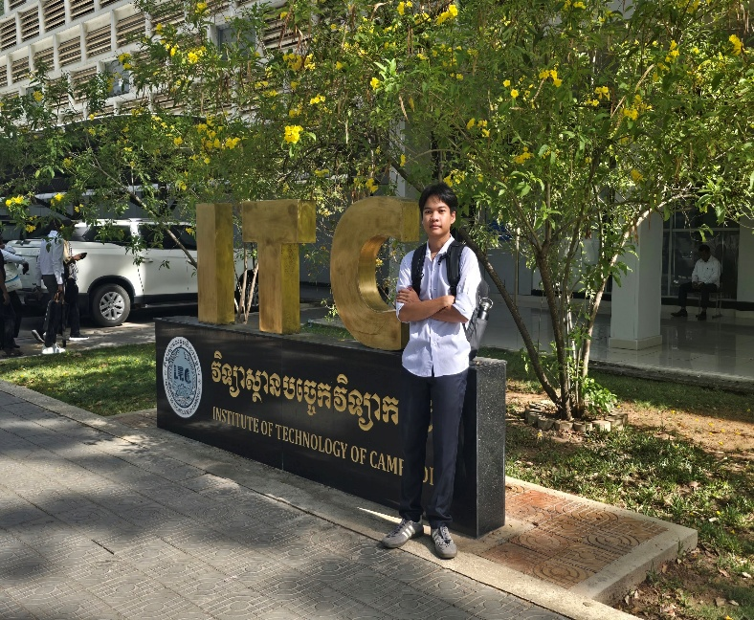
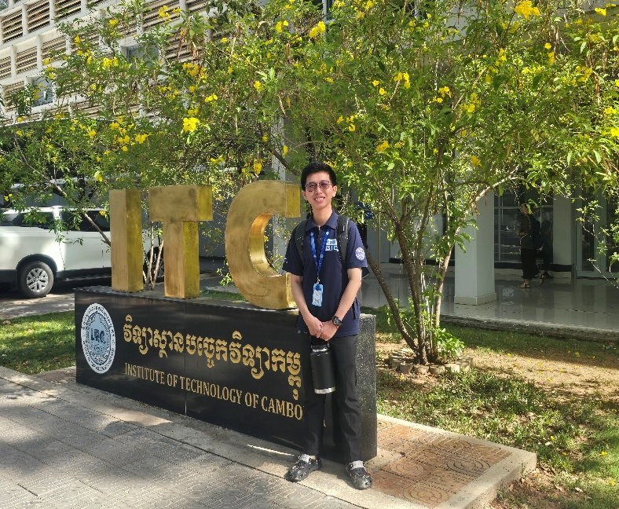
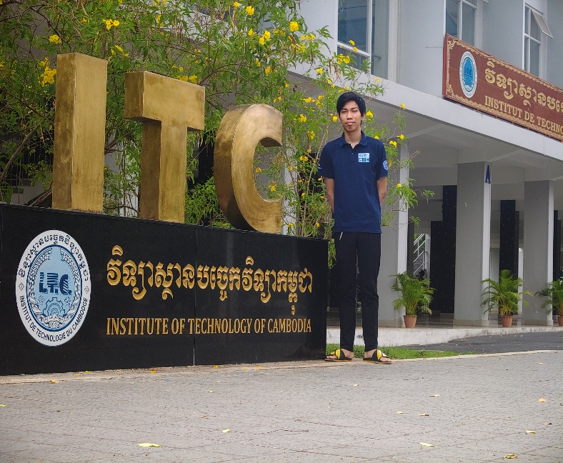
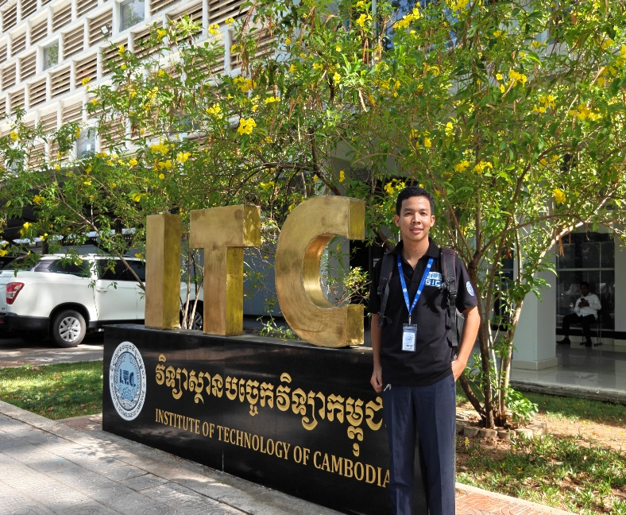
Institute of Technology of Cambodia
Our Team Members
Sean Manutnithya
Taing
Chan Dara
Tang Sovanoudom
Thon Bounthet

Slide 3
Institute of Technology of Cambodia
TEAM MEMBER CONTRIBUTIONS
Members' Name
Role
SEAN MANUTNITHYA
Leader / Divide the task / Monitor Table
TAING CHAN DARA
Membership Table / Documentation
TANG SOVANOUDOM
Coordinate Table / Documentation
THON BOUNTHET
Attendees Table / Presentation Slide

Slide 4
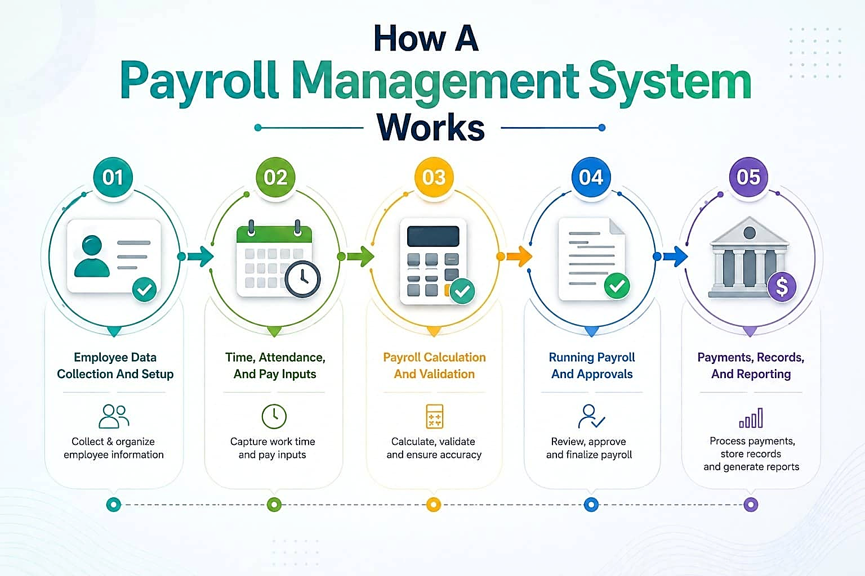
02. Core System Features
Employee management, attendance tracking, and search functions.
06. Conclusion & Demonstration
Summary of achievements, learning outcomes, and future upgrades.
01. Introduction & Purpose
Real-World importance and objectives of a Payroll Management
Institute of Technology of Cambodia
Table Of Content
03. Technical Implementation
Programming Language environment and key C++ Modules.
05. System result
Output Validation, test cases and tax report verification.
04. Data Structure & Logic
Doubly Linked Lists, CSV File handling, and algorithms.

Slide 5
Institute of Technology of Cambodia
Table Of Content
01. Introduction & Purpose
Real-World importance and objectives of a Payroll Management
02. Core System Features
Employee management, attendance tracking, and search functions.
06. Conclusion & Demonstration
Summary of achievements, learning outcomes, and future upgrades.
05. System result
Output Validation, test cases and tax report verification.
03. Technical Implementation
Programming Language environment and key C++ Modules.
04. Data Structure & Logic
Doubly Linked Lists, CSV File handling, and algorithms.

Slide 6





Institute of Technology of Cambodia
Introduction & Purpose
Payroll management Payroll management is a critical organizational process. Our C++ based system automates complex tasks to ensure accuracy in compensation.
Automated working hours tracking.
Precise tax and overtime deduction.
Lightweight CSV file data persistence.

Slide 7
PAYROLL MANAGEMENT SYSTEM
Institute of Technology of Cambodia
01
MAIN
PAYROLL PROCESSING HUB
Core System Features
Central system managing all payroll operations, employee records, tax calculations, and payment scheduling.
DATA SOURCES
Employee Management
The foundation of the system is the Employee Record module, which maintains essential data:
Unique Employee ID and Name validation.
Role-based attributes (Position, Dept).
Wage parameters (Monthly Salary, Hourly Rate).
Contact Info (Phone Number, Gender).
INPUT FILES
02
employee_list.csv
tax_information.csv
attendance.csv
RECORD MANAGEMENT
03
SEARCHING | SORTING
Manage and organize all employee records. Search and sort employee data for efficient payroll processing.
CALCULATE SALARY AND DEDUCTION
NET SALARY COMPUTATION
04
Compute the final net salary for each employee after applying all deductions and tax reductions. Reference: final_salary.csv
TRACK TIME & ATTENDANCE
05
ATTENDANCE TRACKING
Monitor and record employee working hours, overtime, and attendance data for accurate payroll calculation.
PAY SCHEDULE
PAYMENT PLANNING
06
Organize and schedule payment dates for all employees. Manage pay periods and ensure timely disbursement of salaries.
TAX INFORMATION
07
TAX PROCESSING
Retrieve and process tax information for each employee including federal, state, and local tax rates.
PAY EMPLOYEES
SALARY DISBURSEMENT
08
Execute salary payments to all employees via direct deposit or check. Confirm successful payment transactions.
CALCULATE REDUCTION
09
DEDUCTIONS & BENEFITS
Calculate all applicable deductions including taxes, benefits, insurance, and other withholdings from gross salary.
SUBMIT PAYROLL TAX
TAX FILING & PAYMENT
10
Submit payroll tax payments and filings to relevant authorities. Reference: tax_report.csv | tax_filling_history.csv
PAYROLL MANAGEMENT FLOWCHART

Slide 8
PAYROLL MANAGEMENT SYSTEM
01
MAIN
PAYROLL PROCESSING HUB
Central system managing all payroll operations, employee records, tax calculations, and payment scheduling.
DATA SOURCES
INPUT FILES
02
employee_list.csv
tax_information.csv
attendance.csv
RECORD MANAGEMENT
03
SEARCHING | SORTING
Manage and organize all employee records. Search and sort employee data for efficient payroll processing.
CALCULATE SALARY AND DEDUCTION
NET SALARY COMPUTATION
04
Compute the final net salary for each employee after applying all deductions and tax reductions. Reference: final_salary.csv
TRACK TIME & ATTENDANCE
05
ATTENDANCE TRACKING
Monitor and record employee working hours, overtime, and attendance data for accurate payroll calculation.
Institute of Technology of Cambodia
PAY SCHEDULE
PAYMENT PLANNING
06
Core System Features
Organize and schedule payment dates for all employees. Manage pay periods and ensure timely disbursement of salaries.
TAX INFORMATION
Employee Management
The foundation of the system is the Employee Record module, which maintains essential data:
Unique Employee ID and Name validation.
Role-based attributes (Position, Dept).
Wage parameters (Monthly Salary, Hourly Rate).
Contact Info (Phone Number, Gender).
07
TAX PROCESSING
Retrieve and process tax information for each employee including federal, state, and local tax rates.
PAY EMPLOYEES
SALARY DISBURSEMENT
08
Execute salary payments to all employees via direct deposit or check. Confirm successful payment transactions.
CALCULATE REDUCTION
09
DEDUCTIONS & BENEFITS
Calculate all applicable deductions including taxes, benefits, insurance, and other withholdings from gross salary.
SUBMIT PAYROLL TAX
TAX FILING & PAYMENT
10
Submit payroll tax payments and filings to relevant authorities. Reference: tax_report.csv | tax_filling_history.csv
PAYROLL MANAGEMENT FLOWCHART

Slide 9




Institute of Technology of Cambodia
Tracking & Searching
Attendance Tracking
Records working hours, presence, and overtime. Automatically updates employee stats and prepares values for the final payroll calculation.
Linear Search Function
Quickly locate records using Employee ID. The system traverses the linked list to display relevant payroll and personal details instantly.

Slide 10
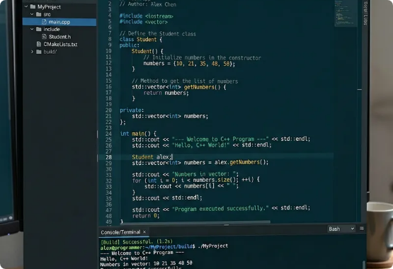
Institute of Technology of Cambodia
Technical Implementation
The system is built as a console-based C++ application, prioritizing performance and modularity.
Language: C++ (GCC/MinGW Compiler).
Modules: Separate headers for Records, Attendance, and Tax Calculation.
Persistence: CSV format for lightweight data storage and portability.

Slide 11
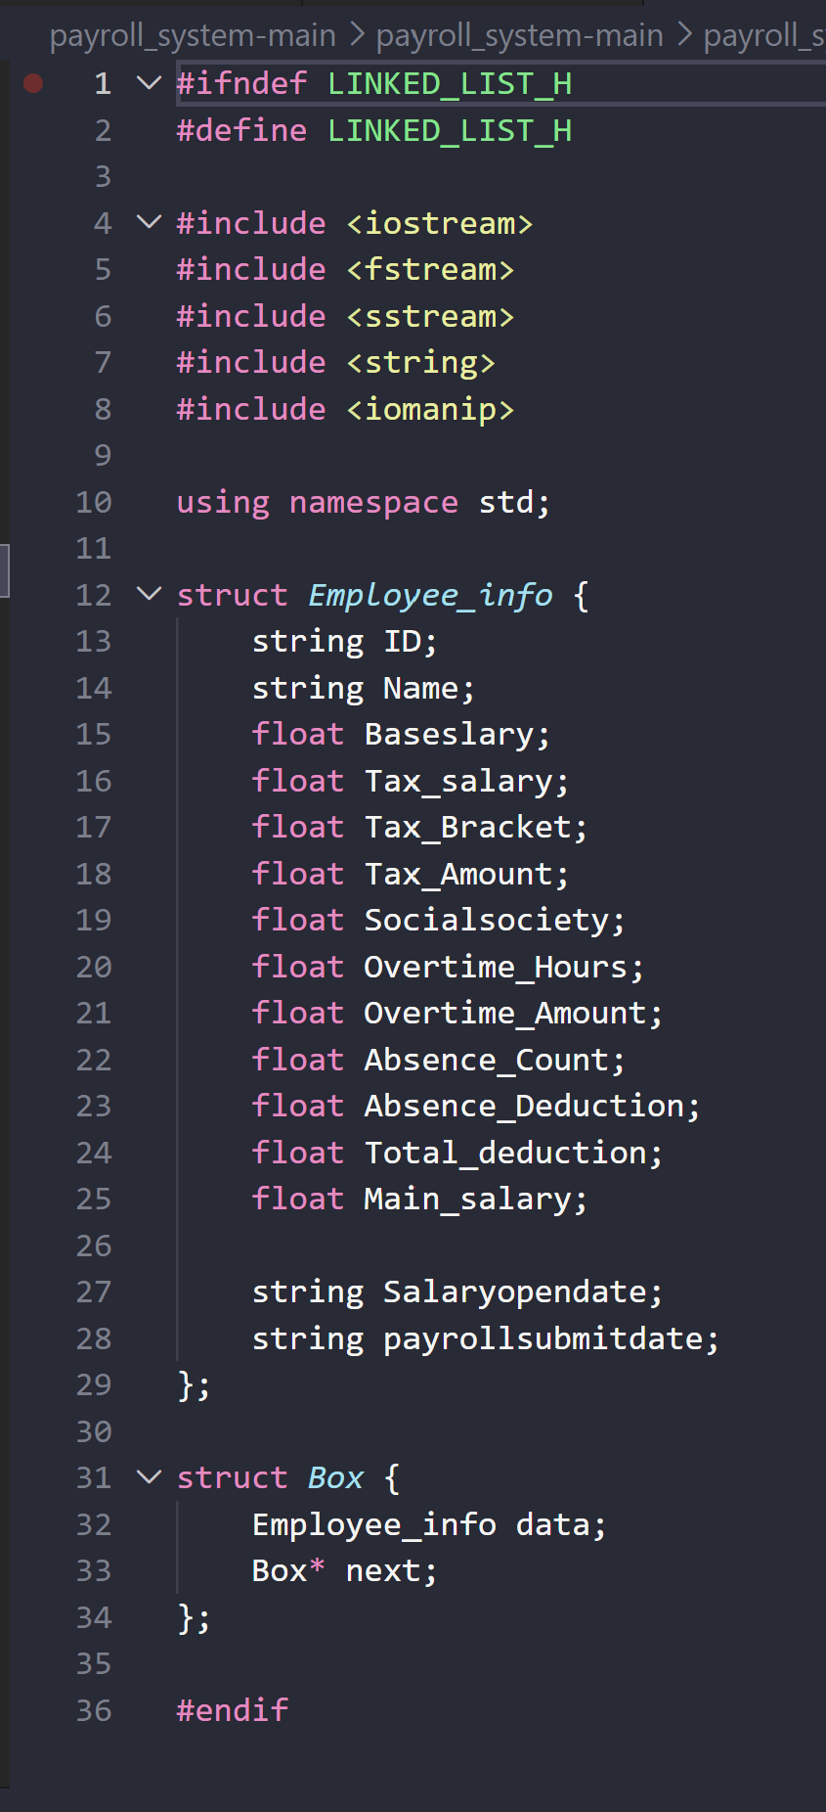
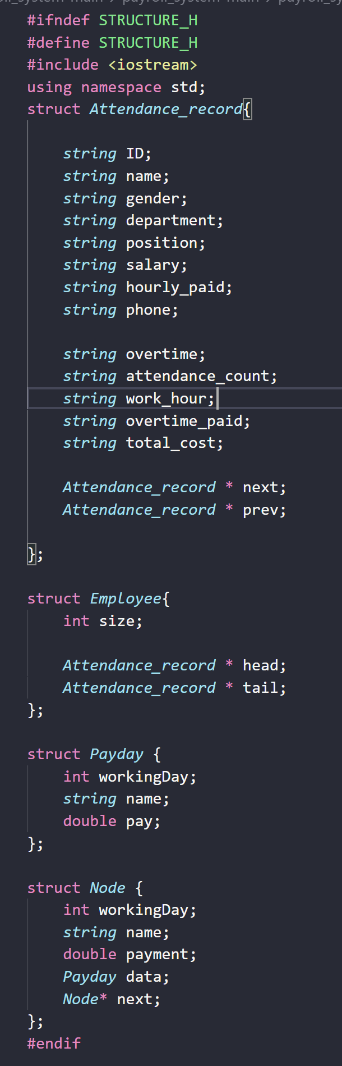
Institute of Technology of Cambodia
Data Structure & Logic
Doubly Linked List Logic
We chose the Doubly Linked List for its flexibility in managing employee nodes:
Dynamic Memory:
Scales without fixed-size arrays.
Bidirectional Traversal:
Easy access to Next and Previous nodes.
Efficiency:
Constant time complexity for insertion and deletion of staff records.
01
02
01

Slide 12

Institute of Technology of Cambodia
File IO
Reading Files
Employee and attendance data are loaded from CSV files into linked lists during program initialization. The system automatically reads existing records at startup, restoring all employee profiles, attendance logs, and payroll data into memory for immediate use.
Writing Files
Updated records are saved back to their respective CSV files after any modifications are made. This ensures full data persistence across sessions — all changes to employee info, attendance, and payroll calculations are retained even after the program closes.

Slide 13
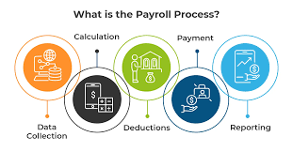

Institute of Technology of Cambodia
System Result
Processing Algorithms
Linear Search
Traverses the list from head to tail to match target IDs for record retrieval.
Bubble Sort
Organizes attendance data in Ascending or Descending order for performance reports.
File Handling
Reads from employee_list.csv and writes back updated payroll information.

Slide 14
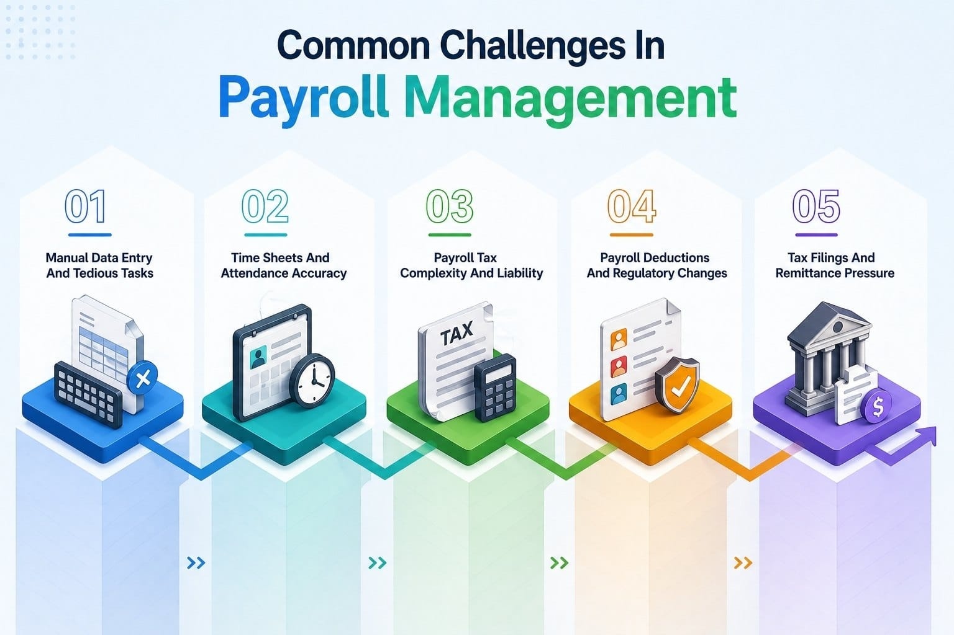
Institute of Technology of Cambodia
SALARY & TAX CALCULATION
The core logic integrates earnings with government tax regulations and attendance deductions.
$${Salary}_{Final}={Salary}_{Base}+{Pay}_{OT}−({Tax}_{Amount}+{Absence}_{Dedu}−Socialsociety)$$
INPUT DATA
ATTENDANCE
CALCULATION
OUTPUT
BASIC SALARY
WORKING HOURS
OVERTIME HOURS
TAX RATE
ATTENDANCE COUNT
OVERTIME = HOURS × HOURLY RATE
ATTENDANCE DEDUCTION APPLIED
TAX AMOUNT = TAX_SALARY × (TAX RATE_BRACKET/100)
AUTOMATED COMPUTATION
FINAL SALARY = BASIC + OVERTIME − TAX_AMOUNT− ABSENCE- NSSF

Slide 15


Institute of Technology of Cambodia
System Result & Validation
Test Case Success
Extensive testing ensured that the system handles edge cases effectively:
Accurate processing of large attendance CSVs.
Proper tax application across different salary tiers.
Validation of ID search and sorting results.
Successful "Submit Payroll" file persistence.
Verified CSV Output
final_Salary.csv

Slide 16
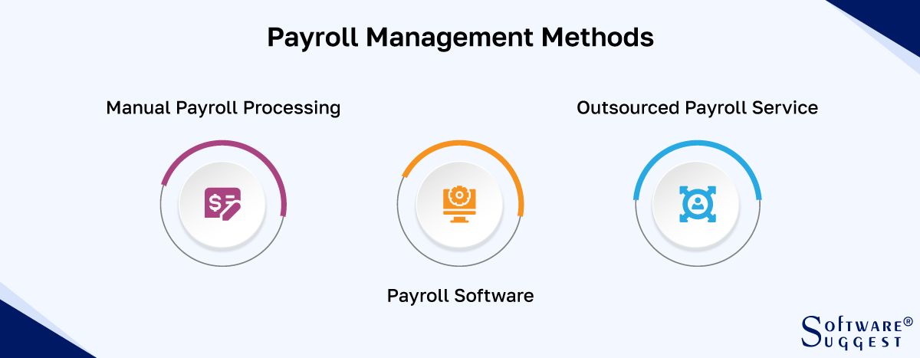

Institute of Technology of Cambodia
Conclusion & Learning
Summary of Achievements
The project successfully integrated data structures with real-world business requirements.
Practical mastery of Linked Lists.
Robust understanding of File I/O in C++.
Enhanced problem-solving and logic skills.
Team coordination and modular design.
01
02
Learning Outcomes
“Combining Program Logic with administrative efficiency to create meaningful software solution”
03
04

Slide 17
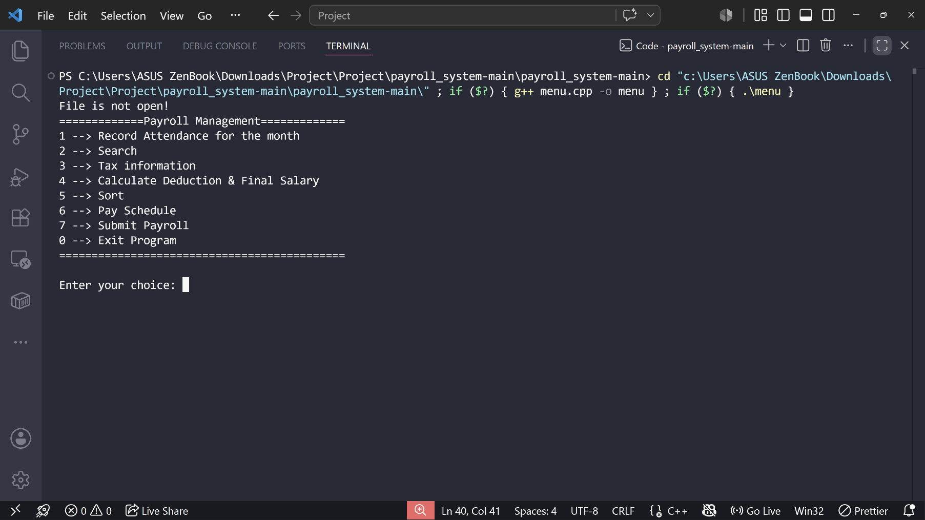
Institute of Technology of Cambodia
Demo code

Slide 18
Institute of Technology of Cambodia
Thank
You
For Your Attention

